Slide 1

Shadows
Shadows
CSCI 440
textbook section 5.10

Slide 2
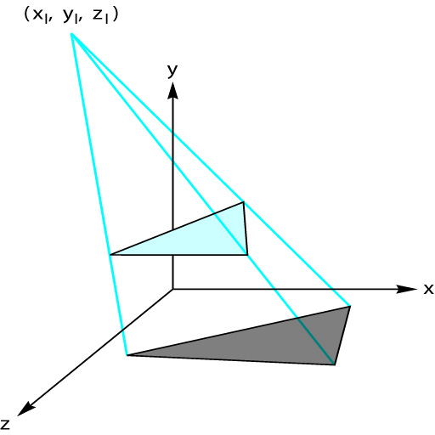
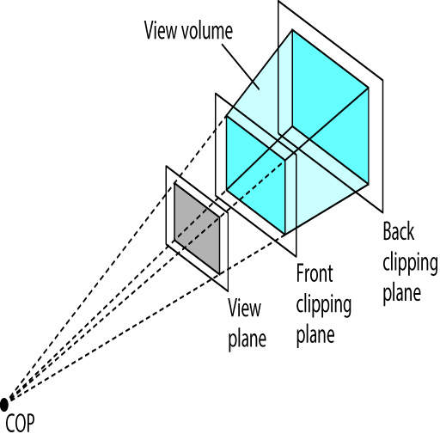
Simple Shadows
How can we create a simple shadow like this?
This is just a special case of a perspective projection.
figures 5.48 and 5.35

Slide 3

Shadow Projection Matrix
║ 1 0 0 0 ║
║ 0 1 0 0 ║
║ 0 0 1 0 ║
║ 0 $\frac{1}{−Ylight}$ 0 0 ║
Code to build this projection
m = mat4();
m[3][3] = 0;
m[3][1] = -1/lightY;
see page 266

Slide 4
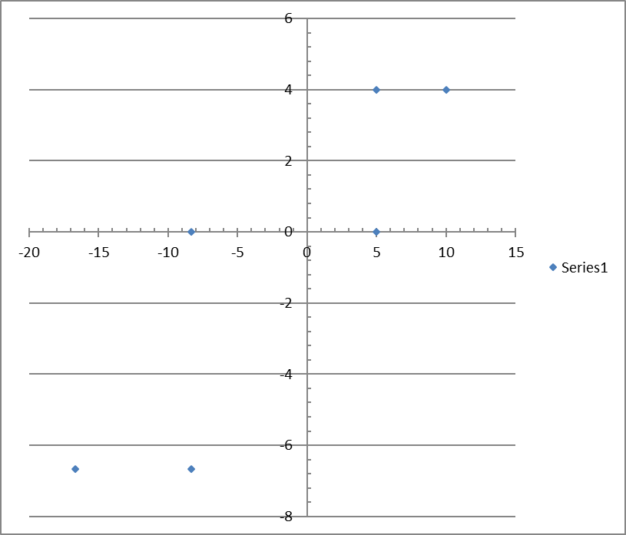
Example Data
Z axis
With Light at height 5
P = [ 5, 3, 0, 1 ]
P' = [ 5, 3, 0, -.6 ]
P'' = [ -8.33, -5.0, 0, 1 ]
P = [ 10, 3, 4 ]
P' = [ 10, 3, 4, -.6 ]
P'' = [ -16.67, -5.0, -6.67, 1 ]
P = [ 5, 3, 4, 1 ]
P'' = [ -8.33, -5.0, -6.67, 1 ]
X axis

Slide 5
Example Data…
With Light at height 5
P = [ 5, 3, 0, 1 ]
P' = [ 5, 3, 0, -.6 ]
P'' = [ -8.33, -5.0, 0, 1 ]
If Light was at Y=10, then shadow would end up at Y = -10.

Slide 6
Z axis
X axis

Slide 7
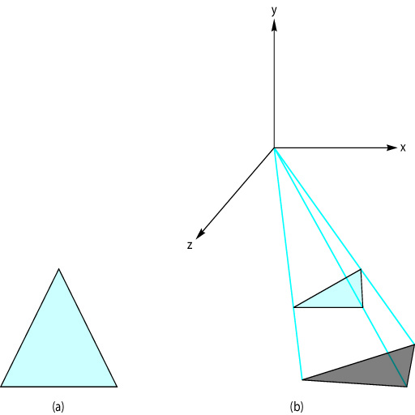
Applying Shadow Matrix
Translate objects so that light source is at origin
Apply shadow projection
Translate back to original location
figures 5.48 and 5.49b

Slide 8
Pseudo Code to draw objects and their shadows
Build a model matrix to transform objects
draw all objects
add the shadow matrix to the model matrix
re-draw all objects

Slide 9
Optimizing
If the location of the light source is a constant, where in the code is the best place to build the shadow matrix?
If the light source moves around, where must the shadow matrix be built?

Slide 10
Limitations
Where does this simple process fail to create a good shadow effect?

Slide 11
Example Code
See course web site.

